Slide 1
Capstone Two Presentation “Personality Traits and Drug Consumption”
Thanh Nguyen

Slide 2
Introduction
Understanding an individual’s risk of drug consumption is critical
Drug overdose is widespread schools and colleges
Drug overdose deaths among seniors more than tripled in two decades
Goal: to predict drug usage using demographic and personal factors
Amyl nitrite (Amyl thereafter)
Cannabis

Slide 3
Overview and agenda
Overview of results
Amyl user prediction - low precision (50%)
Cannabis user prediction - high precision (90%)
Agenda
Dataset
Target, features, and correlation
Feature importance analysis
Modeling and performance on unseen data
Conclusion and future work
Notes:
Amyl prediction is only use as secondary tool
Cannabis can be primary tool

Slide 4
Dataset
University of California, Irvine’s Machine Learning Repository
Online survey methodology
1885 respondents
18 legal and illegal drugs
Target variable
Never Used
Used over a Decade Ago
Used in Last Decade
Used in Last Year
Used in Last Month
Used in Last Week
Used in Last Day
Non-user
User

Slide 5
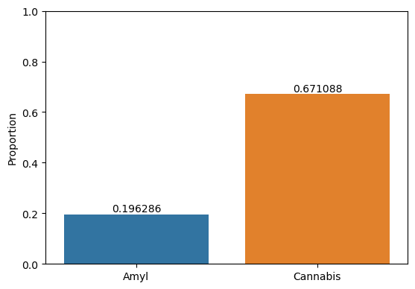
Target
Proportion of Amyl and Cannabis Users

Slide 6
Features
Demographic factors
Gender
Age
Education
Country
Personal traits
Big five personality traits
Neuroticism (measured by Nscore)
Extraversion (Escore)
Openness to experience (Oscore)
Agreeableness (Ascore)
Conscientiousness (Cscore)
Impulsivity and Sensation Seeking (SS)
Notes:
We have half male and half female in the sample
: 6 age groups 18-24, 25-34, 35-44, 45-54, 55-64, and 65+
6 groups from “No high school degree” to “Graduate degree”

Slide 7
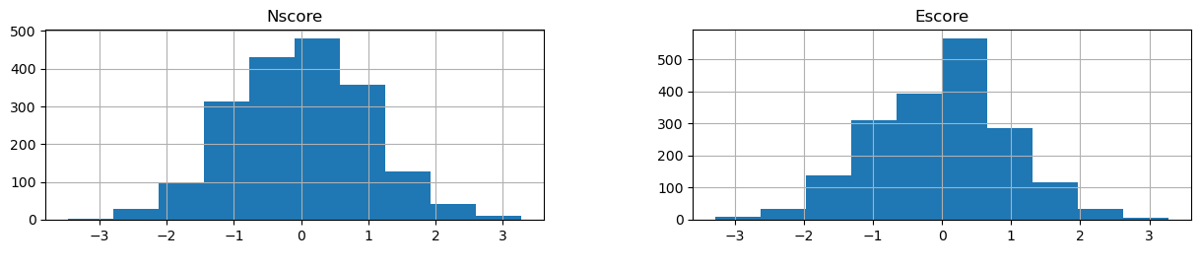
Features
Big five personality traits’ measurement
For each trait, 12 questions asked
Answers: 0 = ‘Strongly Disagree’, 1 = ‘Disagree’, 2 = ‘Neutral’, 3 = ‘Agree’, 4 = ‘Strongly Agree’)
Summarizing and standardizing
Notes:
We have half male and half female in the sample
: 6 age groups 18-24, 25-34, 35-44, 45-54, 55-64, and 65+
6 groups from “No high school degree” to “Graduate degree”

Slide 8
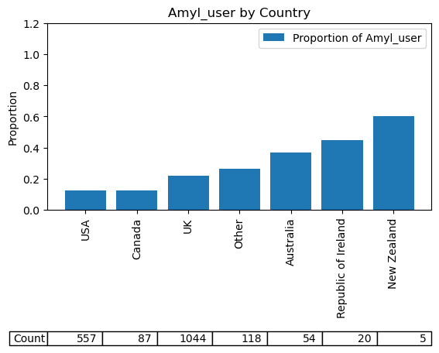
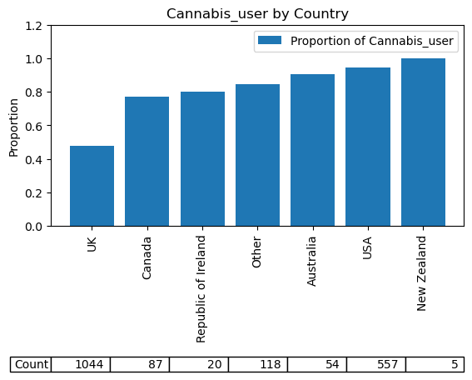
Target-feature relationship
Notes:
We have half male and half female in the sample
: 6 age groups 18-24, 25-34, 35-44, 45-54, 55-64, and 65+
6 groups from “No high school degree” to “Graduate degree”

Slide 9
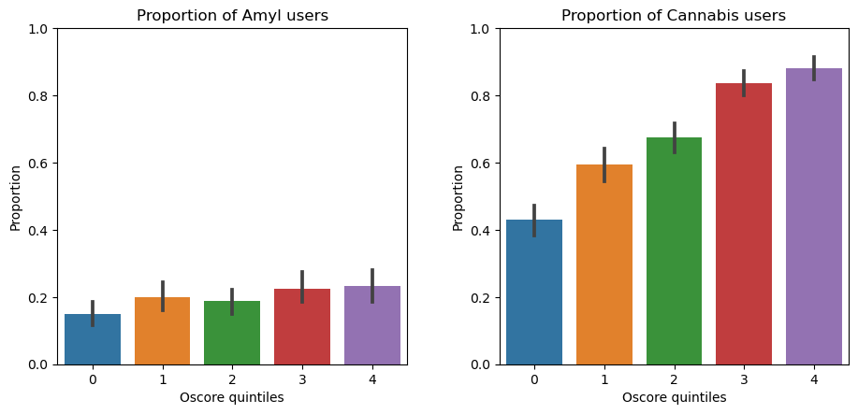
Target-feature relationship
Drug Consumption Across Oscore (Openness to Experience) Quintiles
Notes:
As expected, drug consumption incresase in Oscore
Amyl consumption seems to increase in Oscore.
But relation is not as strong as Cannabis consumption.

Slide 10
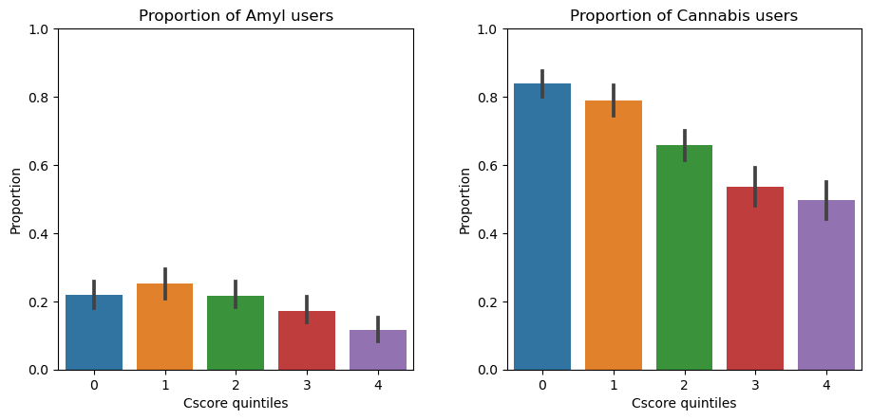
Target-feature relationship
Drug Consumption Across Cscore (Conscientiousness) Quintiles
Notes:
As expected, drug consumption decreases in Cscore
Similar to the prior slide, the relationship is more clear in case of Cannabis than Amyl.
Probably, predicting Cannabis user will be easier than predicting Amyl user.

Slide 11
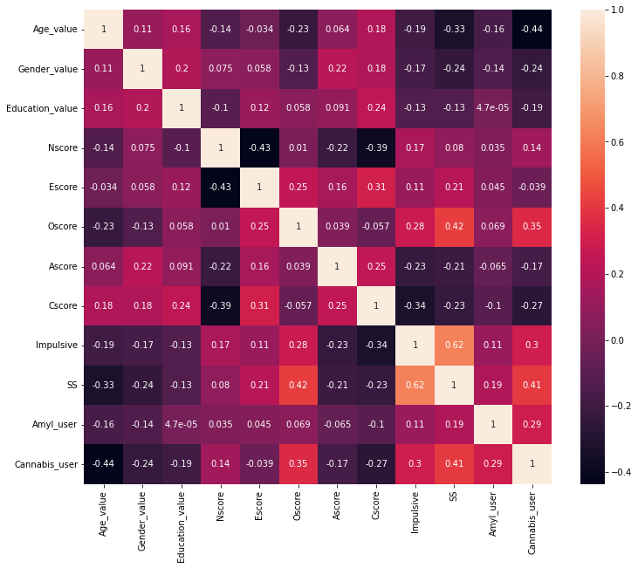
Correlation Matrix
Notes:
Amyl-user/Cannabis-user are zero-and-1 variables. We still can calculate correlation with features.
Again, collelation for Amyl is much smaller compared to correlation with Cannabis => harder to predict Amyl user.
Some high correlation among personality traits => we might have multicollinearity issues
=> might be a subset of features will better predict the target than using all features.

Slide 12
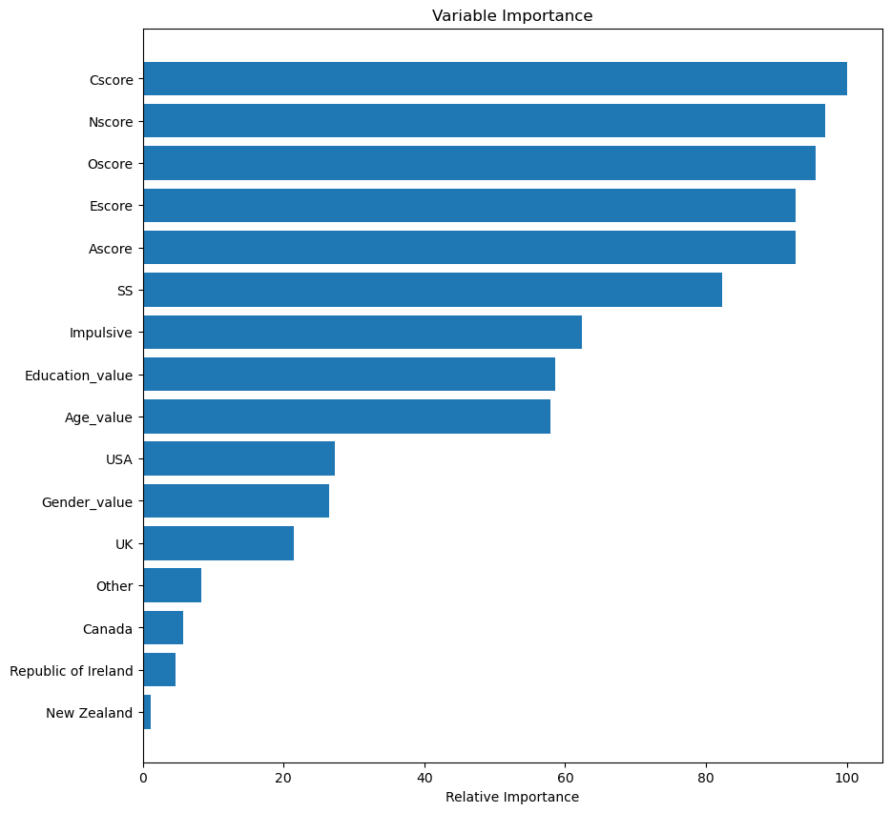
Relative Feature Importance in Predicting Amyl Consumption
Notes:
- For Amyl user, personality traits are very important predictors.

Slide 13
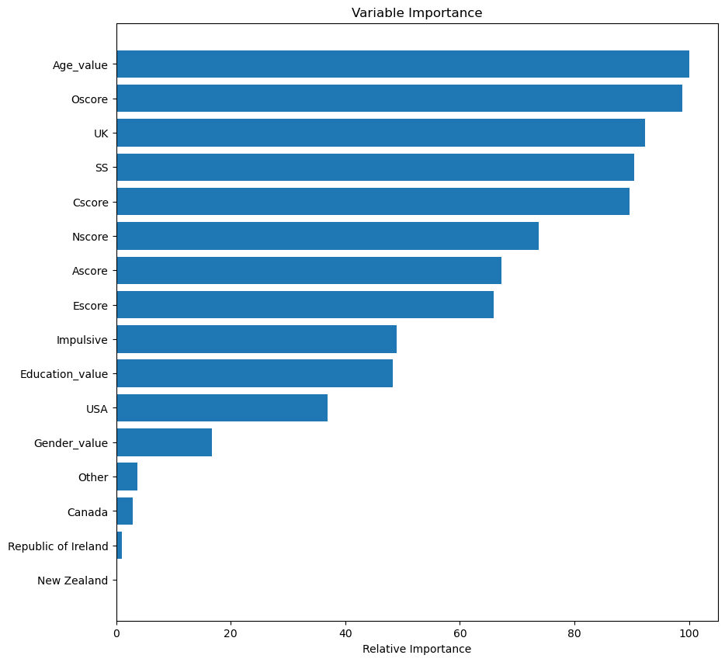
Relative Feature Importance in Predicting Cannabis Consumption
Notes:
For Cannabis, different from Amyl.
Personality traits are still important; but now we have Age and Country.
Cannabis and Amyl are different drugs: one is recreational, the other is illegal.

Slide 14
Modeling
Hyperparameter tuning
Whole samples split into Train set (80%) and Test set (20%)
Choosing optimal classification threshold
Train set split into Main set (70%) and Validation set (30%)
Evaluating performance on Test set
Notes:
Step1 = GridSearchCV to find best hyperparamenters. ROC_AUC as performance measure.
Step2 =
Step3 = refit best model using all Train set, and measure performance on Test set.

Slide 15
Hyperparameter Tuning for Amyl Users Prediction
Model Name | Best Parameters | Optimal Feature Set | Cross-Validation Score (roc_auc)
Random Forest | max_depth = 5 max_features = 'auto' n_estimators = 50 | All features. | 0.7533
Gradient Boosting | learning_rate = 0.05 max_depth = 3 max_features = 8 min_samples_split = 2 n_estimators = 50 subsample = 1 | All features. | 0.7571
Logistic regression | C = 1 penalty = ‘l1' solver = 'liblinear' | All features. | 0.7486
Notes:
- Cross-validation scores are similar. With Gradient boosting is the best.

Slide 16
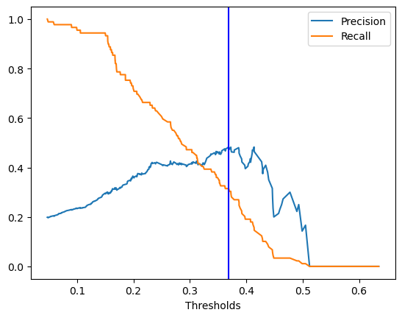
Precision and Recall Curves for Amyl Users Prediction
Optimal Threshold and Test Performance
Test Performance
Precision | Recall | Accuracy
50% | 23% | 80.4%

Slide 17
Hyperparameter Tuning for Cannabis Users Prediction
Model Name | Best Parameters | Optimal Feature Set | Cross-Validation Score (roc_auc)
Random Forest | max_depth = 5 max_features = 0.3 n_estimators = 50 | All features. | 0.8778
Gradient Boosting | learning_rate = 0.02 max_depth = 3 max_features = 6 min_samples_split = 6 n_estimators = 100 subsample = 1.0 | All features. | 0.8780
Logistic regression | C = 0.1 penalty = 'l2' solver = ‘sag' | All features. | 0.8781
Notes:
- Cross-validation scores are similar. With Logistic is the best.

Slide 18
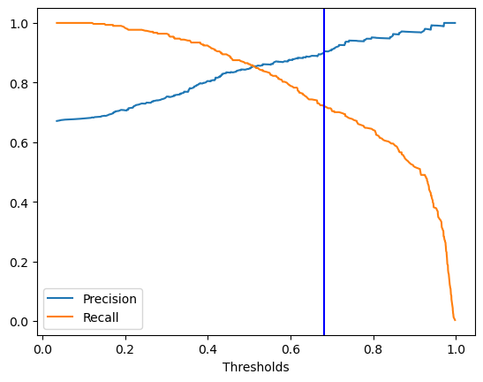
Precision and Recall Curves for Cannabis Users Prediction
Optimal Threshold and Test Performance
Test Performance
Precision | Recall | Accuracy
90.3% | 77.1% | 79%

Slide 19
Conclusion
Amyl user prediction has low precision (50%)
Use as secondary tool in the toolbox of school and healthcare professionals
Cannabis user prediction has high precision (90%)
Use as primary tool
Notes:
-

Slide 20
Future Work and References
Data validity check
Interaction terms among demographic and personal features
References:
E. Fehrman, A. K. Muhammad, E. M. Mirkes, V. Egan and A. N. Gorban, "The Five Factor Model of personality and evaluation of drug consumption risk.," arXiv [Web Link], 2015
UCI Machine Learning Repository: Drug consumption (quantified) Data Set
Opioids: Drug overdose deaths among seniors have more than tripled in 2 decades (cnbc.com)

